Slide 1
Instruction Finetuning
Abhijeet Kumar,
Director, Data Scientist
Fidelity Investments

Slide 2
Agenda
01. State of LLMs
02. Memory Math & Scaling Laws
Available options with us. Why need ?
Challenge - How much memory ? Quantization – Train or Infer Scaling Laws
03. Train models to follow Instructions
04. Finetuning for Use-Case
05. Implementation
1. Sentiment Analysis: text Classification 2. Dialog Summarization. 3. Training Alpaca/Dolly.
FLAN-T5 ALPACA DOLLY etc.
1. Full Finetuning 2. Parameter Efficient Finetuning a) Prompt Tuning b) LORA

Slide 3
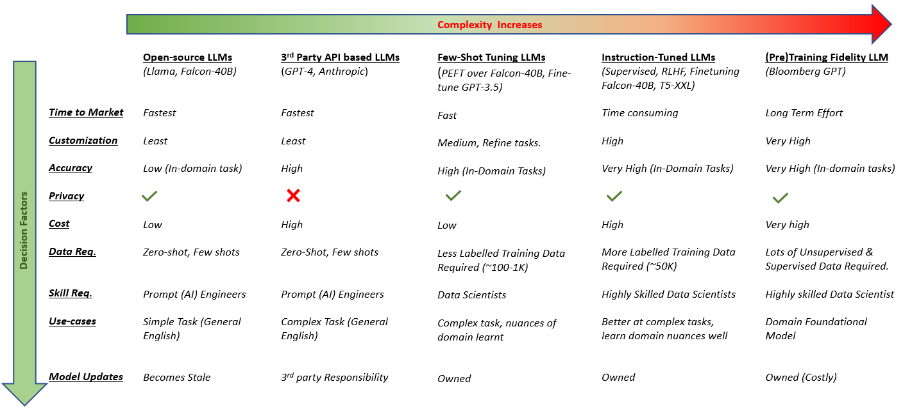

State of LLMs

Slide 4
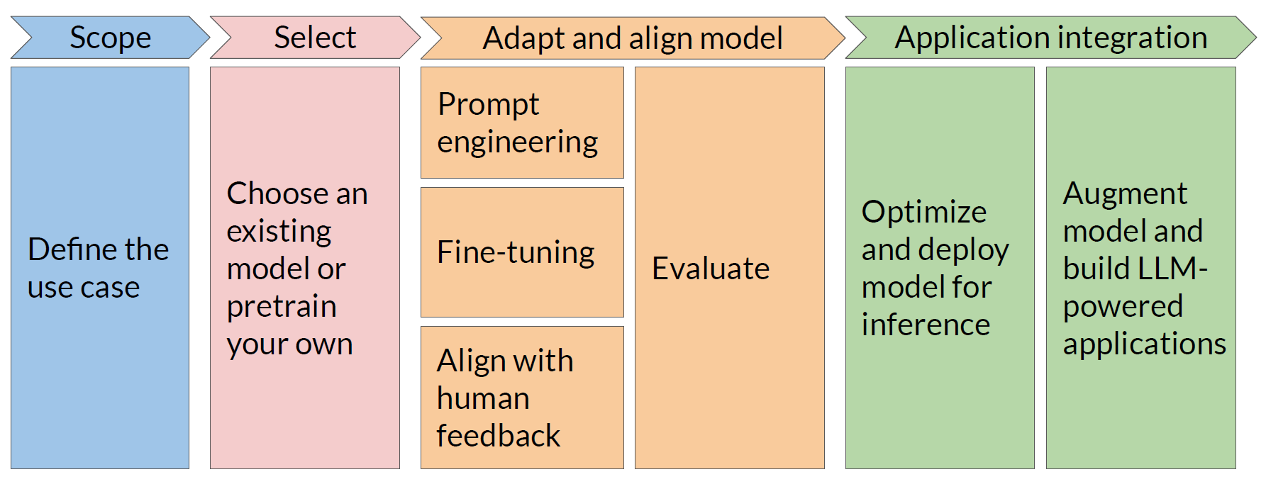
Why modify ?
Coursera reference (for educational purpose)

Slide 5
Why modify ?
Not enough accuracy
Zero-shot Prompt
Single-shot Prompt
Few-shots Prompt
Coursera reference

Slide 6
Why modify ?
Zero-shot Prompt
Single-shot Prompt
Few-shots Prompt
Coursera reference
Parameter Efficient
Full Fine Tuning (SFT)
Prompt Tuning
LORA

Slide 7
Why modify ?
Zero-shot Prompt
Single-shot Prompt
Few-shots Prompt
Coursera reference
Parameter Efficient
RLHF (Human Feedback)
DPO
Full Fine Tuning (SFT)
Prompt Tuning
LORA

Slide 8

Memory Math, Quantization & Scaling Laws

Slide 9
Memory
Param name | Bytes per param
Weights | 4 bytes
Adam states | 8 bytes
Gradients | 4 bytes
Activations & temp memory | 8 bytes
Let’s do a quick math....
1 parameter = 4 bytes (32-bit float)
1B parameters = 4 x 10^9 bytes = 4GB
Approx. GPU needed for 1B param model
175X
14000GB @ 32-bit
full precision
175 Billion GPT-3 Model
20X
80GB @ 32-bit
full precision
4GB @ 32-bit
full precision
Memory needed to inference
Memory needed to train 1B
Hugging Face reference

Slide 10
Memory
Param name | Bytes per param
Weights | 4 bytes
Adam states | 8 bytes
Gradients | 4 bytes
Activations & temp memory | 8 bytes
Let’s do a quick math....
1 parameter = 4 bytes (32-bit float)
1B parameters = 4 x 10^9 bytes = 4GB
Approx. GPU needed for 1B param model with Quantization
175X
7000GB @ 16-bit
Half precision
175 Billion GPT-3 Model
20X
40GB @ 16-bit
half precision
2GB @ 16-bit
half precision
Memory needed to inference
Memory needed to train 1B
Hugging Face reference

Slide 11
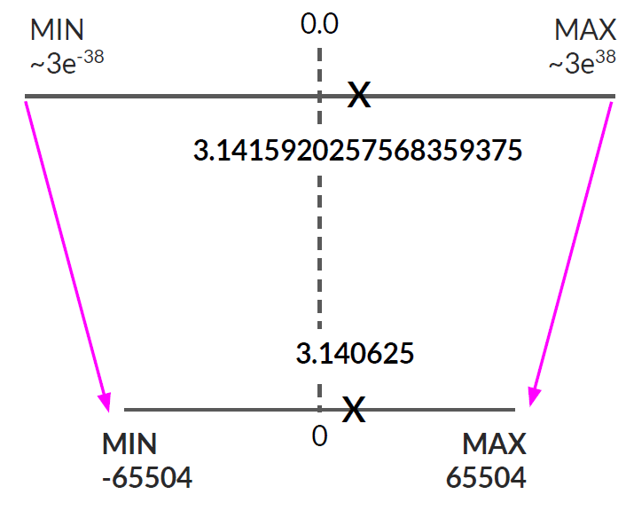
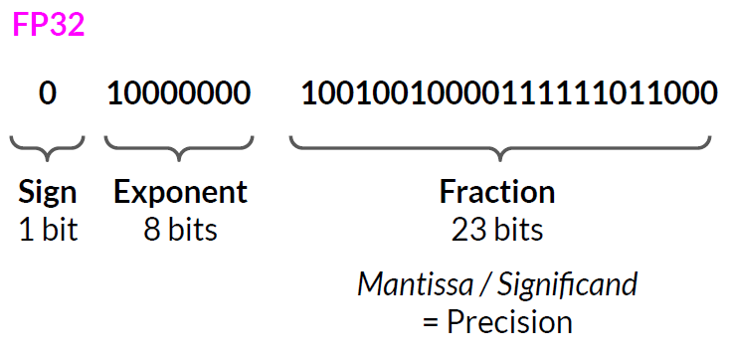
Quantization
Data Type | PI value | Exponent | Fraction
FP32 | 3.1415920257568359375 | 8 | 23
FP16 | 3.140625 | 5 | 10
BF16 | 3.140625 | 8 | 7
INT8** | 3 | 0 | 7
**INT8 & INT4 can only be used for inference (not training)

Slide 12
Training Models to follow instructions

Slide 13
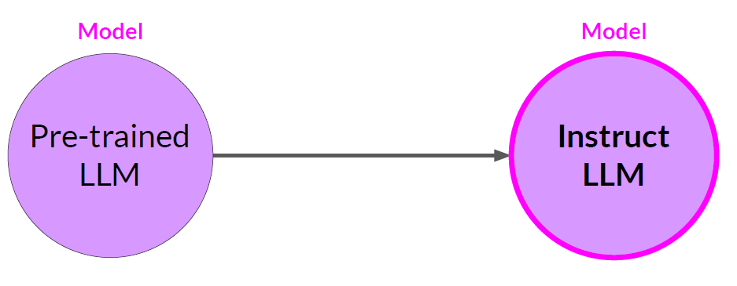
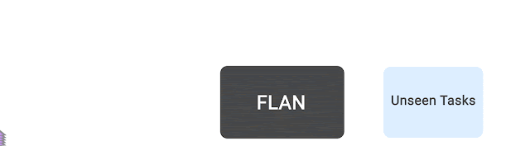
Instruction Following Models
Multi-task Instruction Finetuning from base models
https://ai.googleblog.com/2021/10/introducing-flan-more-generalizable.html

Slide 14
Instruction Following Models
Base Model | Instruction Models | Finetuning ? | Dataset (Task)
T5-XXL | FLAN T5-XXL | SFT | FLAN – 1836 tasks, 15M pairs
Falcon-40B | Falcon-40B-Instruct | SFT | Baize – 100K pairs
Llama2-70B | Llama2-70B-Chat | RLHF | 27.5K pairs, 2.9M pairs
GPT-3.5 | Chat-GPT | RLHF | ------
PALM | Flan-PALM | SFT | FLAN – 1836 tasks, 15M pairs
Pythia | Dolly | SFT | Dolly – 15K pairs
Llama-13B | Alpaca-13B | SFT | GPT3 – 52K pairs
Llama-13B | Vicuna-13B | SFT | GPT-4 – 70K pairs
Llama-13B | Koala-13B | SFT | Public Dialogues - 500K pairs

Slide 15
Instruction Following Models
Base Model | Instruction Models | Finetuning ? | Dataset (Task)
T5-XXL | FLAN T5-XXL | SFT | FLAN – 1836 tasks, 15M pairs
Falcon-40B | Falcon-40B-Instruct | SFT | Baize – 100K pairs
Llama2-70B | Llama2-70B-Chat | RLHF | 27.5K pairs, 2.9M pairs
GPT-3.5 | Chat-GPT | RLHF | ------
PALM | Flan-PALM | SFT | FLAN – 1836 tasks, 15M pairs
Pythia | Dolly | SFT | Dolly – 15K pairs
Llama-13B | Alpaca-13B | SFT | GPT3 – 52K pairs
Llama-13B | Vicuna-13B | SFT | GPT-4 – 70K pairs
Llama-13B | Koala-13B | SFT | Public Dialogues - 500K pairs
Imitating Models

Slide 16
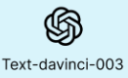
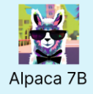

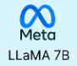
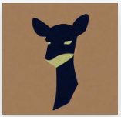

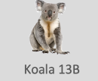

Imitating Models
SFT (100 dollars)
Pythia
SFT (Full Finetuning)
Dolly
SFT (300 dollars)
Databricks
Employees dataset
SFT
Alpaca reference
Vicuna reference
The False Promise of Imitating Proprietary LLMs
Koala reference
Dolly reference

Slide 17
Finetuning for Single Use-case

Slide 18
Why ? Need ?
Fine-tuning can significantly increase the performance of a model on a specific task.
but can lead to reduction in ability on other tasks.
Phenomenon called catastrophic forgetting
Who cares ? use-case solved. (Generalist vs Specialist)
2. Examples take up space in the context window.
Less space for new tokens generated.
Larger prompts leads to slow inferencing.
Show Llama-2-70B-Chat model as example
3. In-context learning may not work for smaller models.

Slide 19

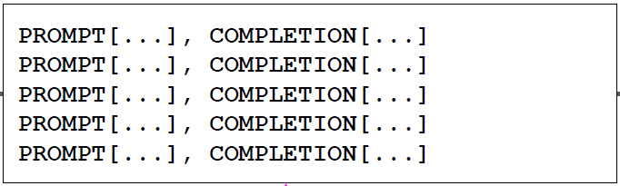
Full Finetuning aka SFT
Task-specific examples
Pretrained LLM
Fine-Tuned LLM
Prompt-completion pairs
Loss: Cross-Entropy
Issues:
Catastrophic forgetting
Hyperparameter optimization
Overfitting
Compute Cost (Budget)
7B param updated
Use instruction models.

Slide 20
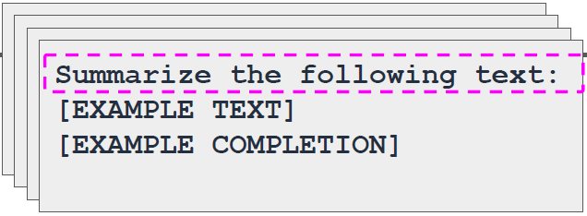
Full Finetuning aka SFT
Single-task training dataset,
e.g. summarization
Pretrained LLM
Fine-Tuned LLM
500-1000 examples needed to fine-tune a single task
Issues:
Catastrophic forgetting
Hyperparameter optimization
Overfitting
Compute Cost (Budget)
7B param updated
Use instruction models.
Loss: Cross-Entropy

Slide 21
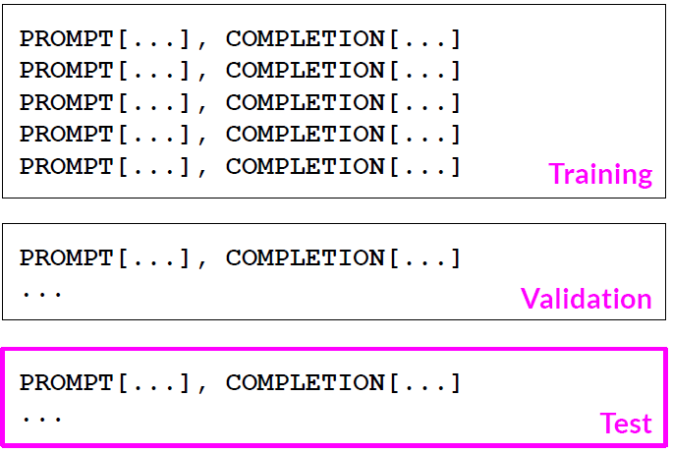
Full Finetuning aka SFT
Pretrained LLM
Fine-Tuned LLM
Issues:
Catastrophic forgetting
Hyperparameter optimization
Overfitting
Compute Cost (Budget)
7B param updated
Use instruction models.
Prepared instruction dataset

Slide 22
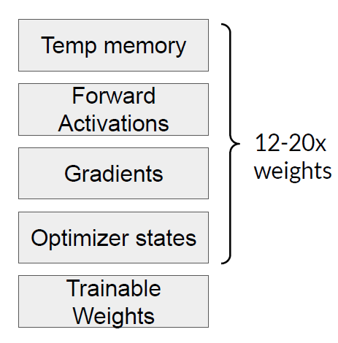
Parameter Efficient Finetuning (PEFT)
Less prone to catastrophic forgetting – Frozen Weights
Full fine-tuning of large LLMs is challenging – Compute budget
Full fine-tuning creates full copy of original LLM per task - Inefficient
PEFT fine-tuning saves space and is flexible
QA-SFT
Llama-2 13B
26GB
Llama-2 13B
Summary-SFT
Llama-2 13B
Deploy separately
3X memory & compute
26GB
Translate-SFT
Llama-2 13B
26GB
Full fine-tuning

Slide 23
Parameter Efficient Finetuning (PEFT)
Less prone to catastrophic forgetting – Frozen Weights
Full fine-tuning of large LLMs is challenging – Compute budget
Full fine-tuning creates full copy of original LLM per task - Inefficient
PEFT fine-tuning saves space and is flexible
QA-SFT
Few K
~2MB
merge
Llama-2 13B
LORA weights
Llama-2 13B
Summary-SFT
Few K
~2MB
Flexible
Saves memory
Translate-SFT
Few K
~2MB
Parameter Efficient Finetuning

Slide 24
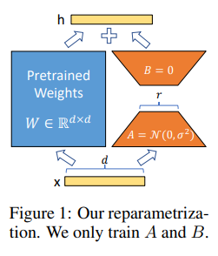
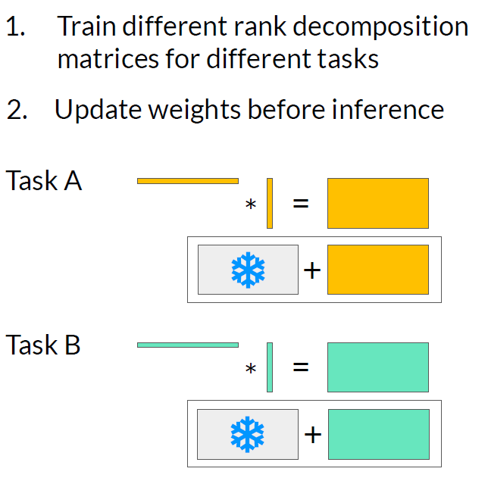
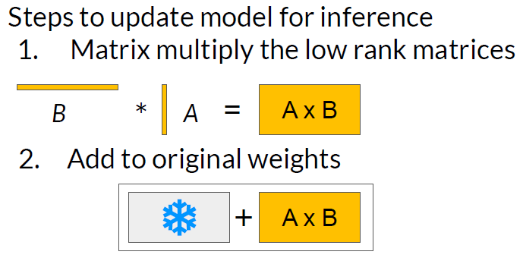
Low Rank Adaption (LORA)
1. Freeze most of the original LLM weights.
2. Inject 2 rank decomposition matrices
3. Train the weights of the smaller matrices
Advantage (Rank=8)
512X64 = 32,768 params
512 x 8 = 4,096 (A)
8 x 64 = 512 (B)
86% reduction in params
LORA paper reference

Slide 25
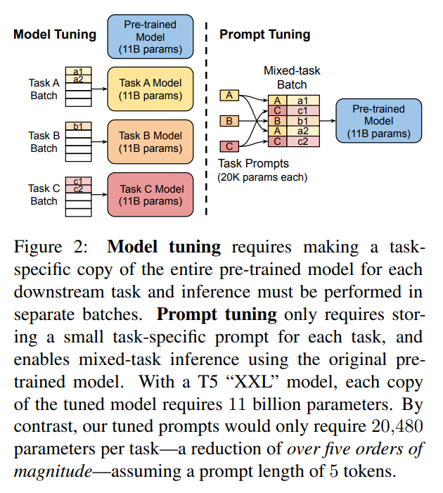
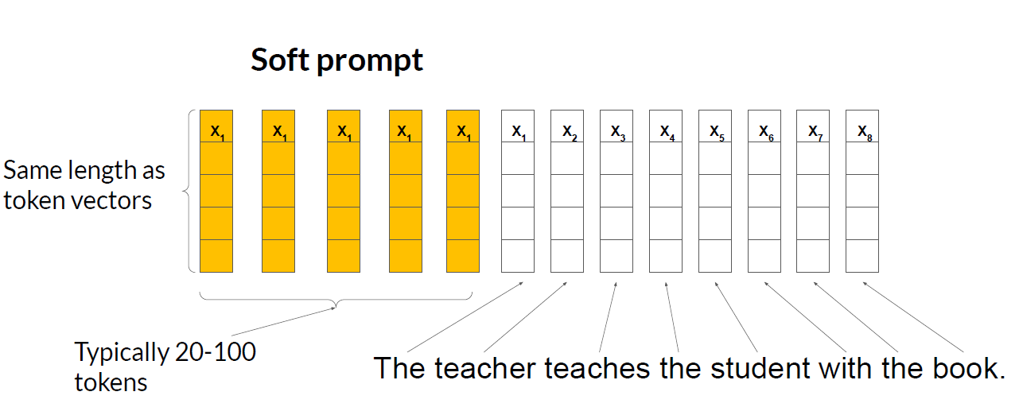
Prompt Tuning
Prompt-Tuning paper reference

Slide 26
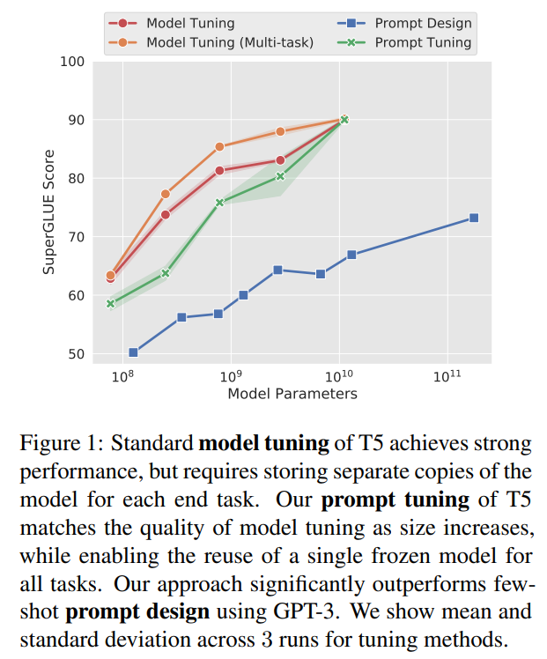
Prompt Tuning
Prompt Tuning == SFT
Prompt-Tuning paper reference

Slide 27
Guidelines: Finetuning for Use-case
Use instruct models for Finetuning for single task.
Example, Llama-chat. FLAN-T5 (not base models)
Quality of training data is very important
Use PEFT techniques, oppose to Full Finetuning
Research proves high quality datasets performs well even if quantity is less.
Example: Plug LORA adapters for specific use-case
Do not go for Full Finetuning. Finding right hyperparameter is difficult.
Unless you have the compute budget and lot of training data.

Slide 28

Thank you

